Slide 1
Introduction to the MCSDK

Slide 2
Agenda
MCSDK Overview
Software Architecture
Evaluation Module (EVM)
MCSDK Benefits

Slide 3
MCSDK Overview
MCSDK Overview
Software Architecture
Evaluation Module (EVM)
MCSDK Benefits

Slide 4
What is MCSDK?
The Multicore Software Development Kit (MCSDK) provides the core foundational building blocks for customers to quickly start developing embedded applications on TI high performance multicore DSPs.
Uses the SYS/BIOS or Linux real-time operating system
Accelerates customer time to market by focusing on ease of use and performance
Provides multicore programming methodologies
Available for free on the TI website bundled in one installer, all the software in the MCSDK is in source form along with pre-built libraries

Slide 5
Software Development Ecosystem Multicore Performance, Single-core Simplicity
Eclipse
Code
Composer
StudioTM
Third
Party
Plug-Ins
Editor
PolyCore
CodeGen
OpenMP
ENEA
Optima
Multicore Software Development Kit
Profiler
3L
Debugger
Critical
Blue
Remote
Debug
Multicore System
Analyzer
Visualization
Host Computer
Target Board
XDS 560 V2
XDS 560 Trace

Slide 6
MCSDK Variants
Name | Release | DSP | ARM | OS | Notes
BIOS-MCSDK | 1.x, 2.x | x | NA | SYS/BIOS | DSP-only SOC running SYS/BIOS real-time operating system
Linux-MCSDK | 1.x, 2.x | x | NA | Linux on DSP | DSP-only SOC running Linux real-time operating system

Slide 7
Software Architecture
MCSDK Overview
Software Architecture
Evaluation Module (EVM)
MCSDK Benefits

Slide 8
Migrating Development Platform
TI Demo Application on TI Evaluation Platform
TI Demo Application on Customer Platform
Customer Application on Customer Platform
Customer App on Next Generation TI SOC Platform
Demo Application
Demo Application
Customer Application
Customer Application
Tools
(UIA)
EDMA, Etc
Tools
(UIA)
EDMA, Etc
Tools
(UIA)
EDMA, Etc
Tools
(UIA)
EDMA, Etc
Network
Dev Kit
Network
Dev Kit
Network
Dev Kit
Network
Dev Kit
LLD
IPC
TI Platform
LLD
IPC
Customer Platform
LLD
IPC
Customer Platform
LLD
IPC
Next Gen TI Platform
CSL
CSL
CSL
CSL
No modifications required
Software may be different, but API remain the same (CSL, LLD, etc.)
May be used “as is” or customer can implement value-add modifications
Needs to be modified or replaced with customer version

Slide 9
BIOS-MCSDK Software
Demonstration Applications
HUA/OOB
IO Bmarks
Image
Processing
Software Framework Components
Communication Protocols
SYS/BIOS
RTOS
Interprocessor
Communication
Instrumentation
(MCSA)
TCP/IP
Networking
(NDK)
Algorithm Libraries
Platform/EVM Software
DSPLIB
IMGLIB
MATHLIB
Platform
Library
Transports - IPC - NDK
Low-Level Drivers (LLDs)
Resource
Manager
POST
EDMA3
PA
SRIO
FFTC
TSIP
OSAL
Bootloader
PCIe
QMSS
CPPI
HyperLink
…
Chip Support Library
Hardware

Slide 10
Interprocessor Communication (IPC)
Device 1
Device 2
IPC Transports | Task to Task | Core to Core | Device to Device
Shared Memory | x | x
Navigator/QMSS | x | x
SRIO | x | x | x
PCIe | x | x | x
HyperLink | x | x | x
Core 1
Core 2
Core 1
Core 2
BIOS
Process 1
Process 2
BIOS
Process 1
Process 2
BIOS
Process 1
Process 2
BIOS
Process 1
Process 2
IPC
IPC
IPC
IPC
SoC Hardware and Peripherals
SoC Hardware and Peripherals
Device 1
Core 1
Core 2
Core 3
Core N
Linux
Process 1
Process 2
BIOS
Process 1
Process 2
BIOS
Process 1
Process 2
BIOS
Process 1
Process 2
SysLink
IPC
IPC
IPC
SoC Hardware and Peripherals

Slide 11
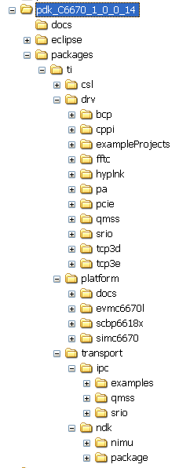
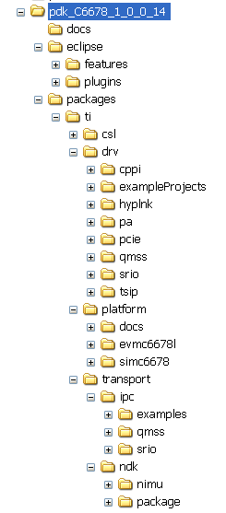
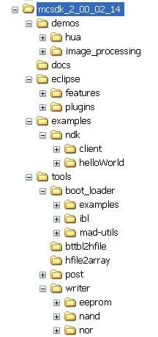
Packaging (BIOS-MCSDK)

Slide 12
Evaluation Module (EVM)
MCSDK Overview
Software Architecture
Evaluation Module (EVM)
MCSDK Benefits

Slide 13
Linux/BIOS MCSDK C66x Lite EVM Details
EVM Flash Contents
DVD Contents
EEPROM
128 KB
NOR
16 MB
NAND
64 MB
POST
BIOS MCSDK
“Out of Box” Demo
Linux MCSDK
Demo
Factory default recovery
EEPROM: POST, IBL
NOR: BIOS MCSDK Demo
NAND: Linux MCSDK Demo
EEPROM/Flash writers
CCS 5.0
IDE
C667x EVM GEL/XML files
BIOS MCSDK 2.0
Source/binary packages
Linux MCSDK 2.0
Source/binary packages
IBL
Online Collateral
TMS320C667x processor website http://focus.ti.com/docs/prod/folders/print/tms320c6678.html http://focus.ti.com/docs/prod/folders/print/tms320c6670.html
MCSDK website for updates http://focus.ti.com/docs/toolsw/folders/print/bioslinuxmcsdk.html
CCS v5 http://processors.wiki.ti.com/index.php/Category:Code_Composer_Studio_v5
Developer’s website Linux: http://linux-c6x.org/
BIOS: http://processors.wiki.ti.com/index.php/BIOS_MCSDK_2.0_User_Guide
Notes:
13

Slide 14
MCSDK Benefits
MCSDK Overview
Software Architecture
Evaluation Module (EVM)
MCSDK Benefits

Slide 15
MCSDK Benefits
Faster time to market for end-customer products
Stable foundation of optimized software components
Multicore programming methodologies
Free, full source code
Easy-to-use, hardened API
Modular software architecture to simplify migration to future SOC
Built-in demonstrations showcasing SOC strengths and multicore software framework
Positive customer out-of-box experience
Software ecosystem with third-party tools
Documentation: Online wiki
Support: E2E forum

Slide 16
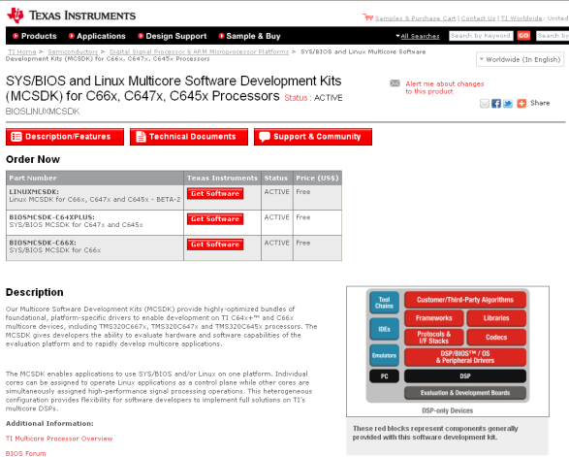
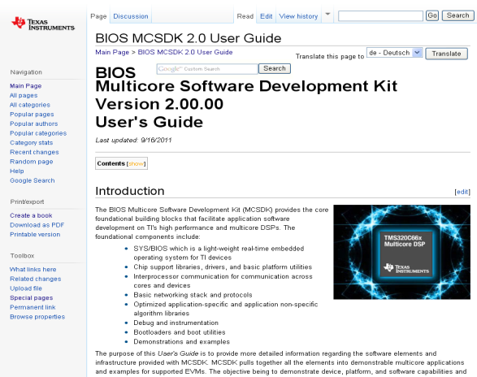
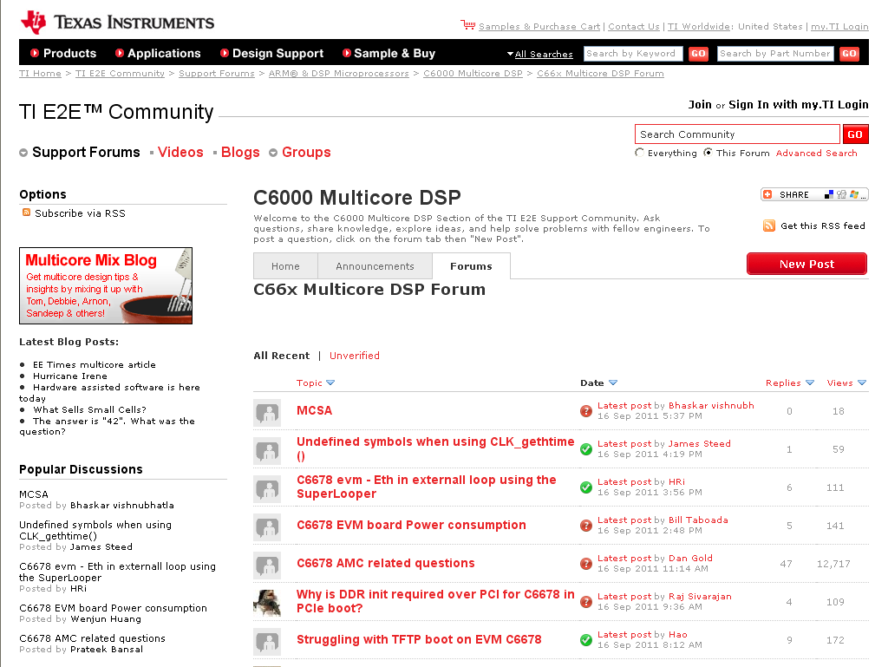
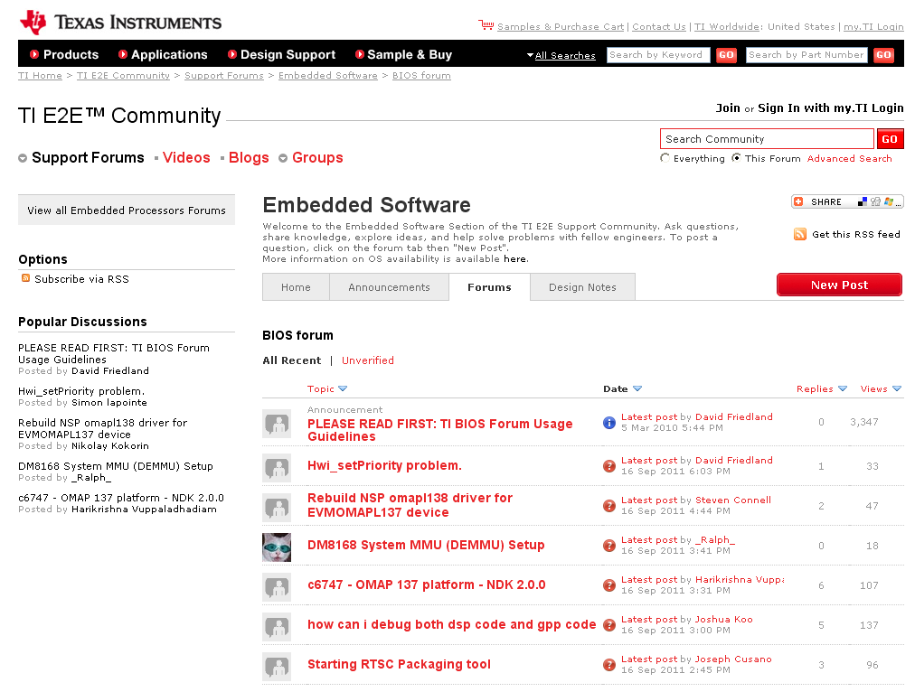
For More Information
Download MCSDK software:
http://focus.ti.com/docs/toolsw/folders/print/bioslinuxmcsdk.html
Refer to the MCSDK User’s Guide:
http://processors.wiki.ti.com/index.php/BIOS_MCSDK_2.0_User_Guide
Download Software
User’s Guide
For questions regarding topics covered in this training, visit the following e2e support forums:
http://e2e.ti.com/support/dsp/c6000_multi-core_dsps/f/639.aspx
http://e2e.ti.com/support/embedded/f/355.aspx
Software Forums

